Slide 1
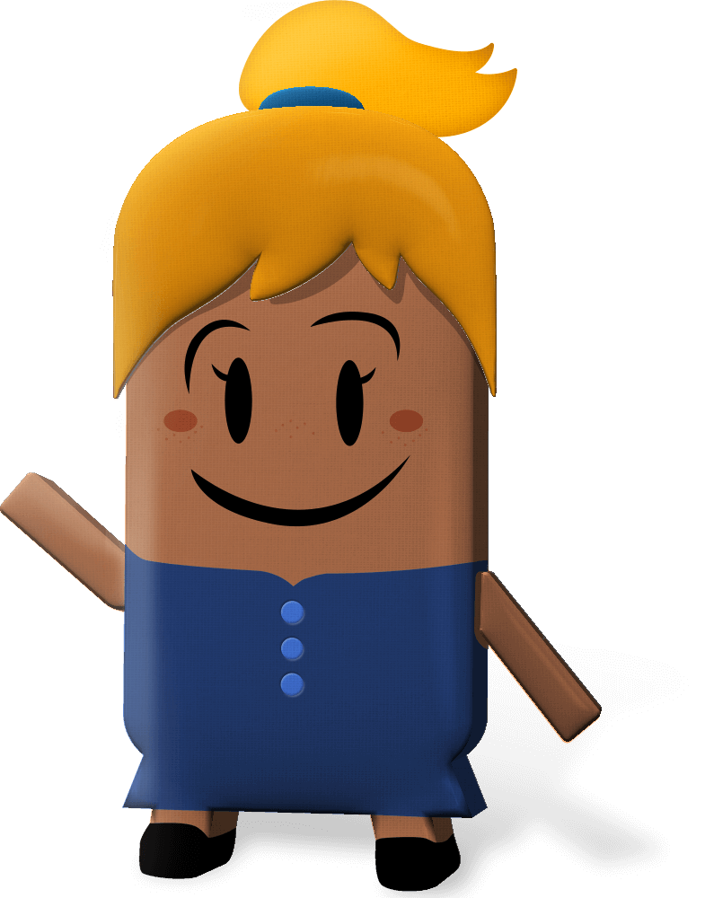
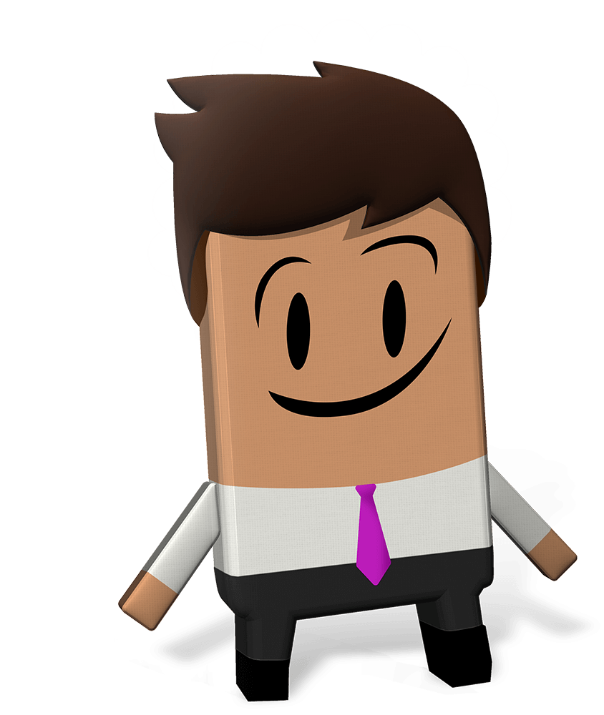
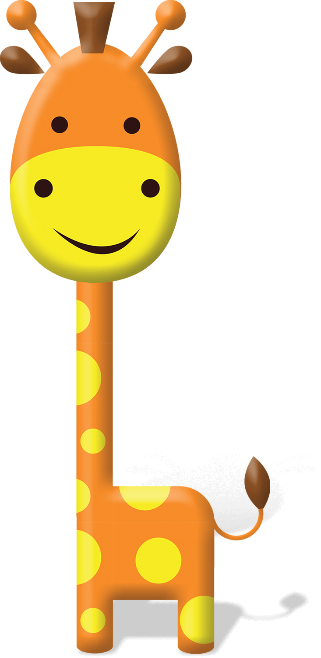
OUR WORLD IRISH AID AWARDS 2021
“Global Goal Getters”
LESSON FOUR
(3rd-4th & 5th-6th class)
Notes:
Dear teacher,
Welcome to the fourth and final lesson available for the 2021 Our World Irish Aid Awards.*
Irish Aid is the official overseas development cooperation programme of the Irish Government. The Government’s overseas development programme focuses on the realization of the United Nations Sustainable Development Goals with a specific emphasis on gender equality, reducing humanitarian need, supporting climate action, and strengthening governance in over 130 countries. The Our World Irish Aid Awards were established in 2005 to encourage primary aged pupils to learn about how Ireland, through the Irish Aid programme, is working on these issues in partnership with international organizations (like the United Nations and the European Union), with governments, non-governmental organizations (NGOs), and with communities of people.
We are delighted that you have decided to take part in the Awards this year. You may already have done some, or all, of the 2021 Our World Irish Aid Awards pupils’ magazine and lessons 1-3, and we hope that your class found the activities and stories engaging and fun.
All our lessons are designed for approximately 45 minutes of class contact time. They are curriculum linked (see Slide 2) and classroom-ready, with minimal preparation required on your behalf (see Slide 3). However, we recognise that as their teacher, you know your own pupils very well. For this reason, the slides are fully editable so that, if necessary, you can tweak the lesson content to best suit the context and needs of the children in your class. You may also find it helpful to download our Good Practice Guidelines for teaching about poverty and development (https://www.ourworldirishaidawards.ie/lesson-plans-2020-2021/).
This final lesson invites you to take your involvement one step further and submit content for publication in our brand new, Global Goal Getters online magazine by kids, for kids. We are publishing three issues of the Global Goal Getters online magazine, between February - May 2021.
All that remains is for you to read through the teacher notes (available at the bottom of each slide when in ‘normal’ mode) and familiarise yourself with the animations (using presenter mode) in advance of class. Depending on your version of PowerPoint you may be able to view the slide notes while in presentation mode, but don’t worry, if not, you can access and print a pdf of the slide notes as a support for you during class (https://www.ourworldirishaidawards.ie/lesson-plans-2020-2021/). Please note that when slide notes text is in italics, it is meant for you and is not intended to be shared with pupils.
*If you have colleagues teaching 3rd-4th or 5th-6th class, you might like to let them know that curriculum-linked lessons for their stage are available on www.ourworldirishaidawards.ie
Every year we are blown away by the creativity and innovation of teachers and pupils around the country who take part in the Awards. We can’t wait to see where you go with this year’s theme of ‘Partnership for the Goals’. Remember to share your Our World Irish Aid Awards 2021 journey with us @Irish_Aid / @ourworldawards on social media using the hashtag #ourworldawards.
All the very best to you and your wonderful pupils.

Slide 2
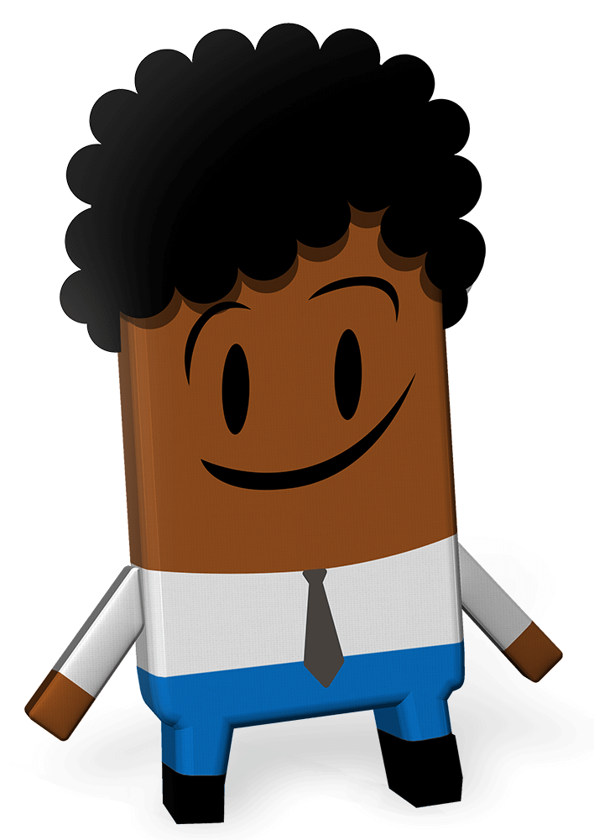
Curriculum Links
Curriculum area | Subject | Strand
Primary language | English | Oral language Reading Writing
 | Gaeilge | Teanga ó Bhéal Léitheoireacht Scríbhneoireacht
SESE | Geography | Human environments
SPHE |  | Myself and the wider world
Visual Art | Drawing | Making drawings
Notes:
Teacher notes: Curriculum links (none)

Slide 3
Lesson Content
Activity No. | Activity name | Methodologies | Slide No.
Learning Intentions |  |  | 4
1 | One-minute challenge | The Goals are the answer: video One-minute revision challenges | 5-6
2 | Generating ideas | Input Mind mapping and class discussion to decide on the content focus and format of submissions for the online magazine, Global Goal Getters, by kids, for kids*** | 7-13
3 | Global Goal Getters | End of lesson reflection | 14-15
*** This is the only activity which may, depending on your class, require preparation of materials – print Slide 8
(mind map template). The number of copies you will need will depend on whether you decide to get pupils to do this activity individually, in pairs or small groups (see notes Slide 7).
Notes:
Teacher notes: Lesson Content (none)

Slide 4
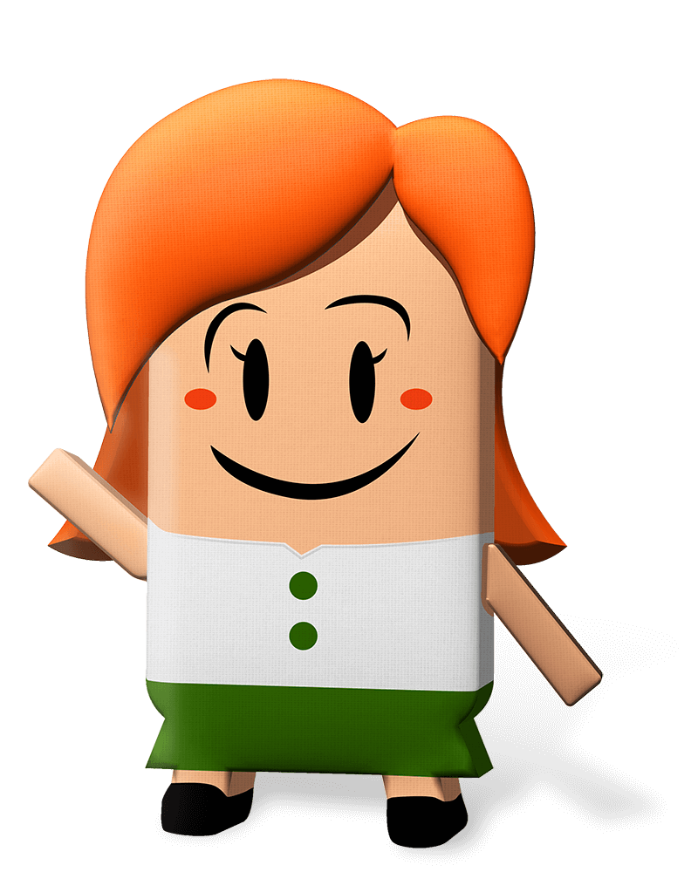
We are…
learning how we can enter our work to appear in Irish Aid’s Global Goal Getters online magazine, by kids, for kids
revising key content from Lessons 1-3
Notes:
Teacher notes: Learning intentions (2 consecutive animations at * Click)
Depending on your class, you might like to share the learning intentions on this slide at the start of the lesson.
* Click to animate in the three learning intentions for this lesson, one after another, reading aloud as you go.
Sensitivity note:
As their teacher, you know your own pupils well. Please feel free to edit the learning intentions and the activities in this lesson to best suit the context and needs of the children in your class.
See also our Good Practice Guidelines for teaching about poverty and development in the lesson plan section of our website: www.ourworldirishaidawards.ie

Slide 5
Activity 1
Slide 1 of 2 | One-minute challenge
Notes:
Teacher notes: Activity 1/Slide 1 of 2 (One-minute challenge) (no animation)
Play ‘The Goals are the answer’ video (1.47mins) by clicking the image on the slide.
Depending on your class, you might like to play the video a second time.
Remind the class that the Government of Ireland’s programme for overseas development cooperation is called Irish Aid.
Irish Aid works in partnership with other governments, with different groups (NGOs or charities), and with communities, in countries all over our world, to try to make the Global Goals happen; so that everyone everywhere, now and in the future, can live in a better world.

Slide 6
Activity 1
Write down as many sentences as possible using the word ‘Partnership’
List as many Global Goals for Sustainable Development as you can
Draw a picture or a few different pictures to show what you know about the work of Irish Aid
Retell Mamcy Karina’s story in your own words
Slide 2 of 2 | One-minute challenge
Notes:
Teacher notes: Activity 1/Slide 2 of 2 (One-minute challenge) (no animation)
Invite pupils to think about their engagement with the Our World Irish Aid Awards magazine and/or lesson plans #1, # 2 and # 3 (available: www.ourworldirishaidawards.ie).
Depending on your class you might like to prompt pupils by reminding them that:
Lesson 1 focused on the Global Goals for Sustainable Development
Lesson 2 was about the work that Irish Aid (Ireland’s official overseas development cooperation programme) does in partnership with governments, international agencies (like the United Nations World Food Programme), non-governmental organizations (or charities) and communities.
In Lesson 3, the class learned about refugees and in particular about the refugee experiences of Mamcy Karina from South Sudan.
NB: Remember, you can edit the slide and remove one or more challenges if your class didn’t engage with all 3 Our World Award lessons. If you think your pupils need more than one minute to complete tasks, you can adapt the instruction accordingly.
Read the challenges on the slide aloud to the class.
Explain to the class that they have one minute ‘thinking time’ to decide which challenge they would like to do.
Start the timer. Depending on your class, you might like to display an online timer on the board.
Divide the class into pairs.
Explain that each person will have one minute to complete their chosen challenge. If anyone finishes their challenge before the one-minute is up, they can try to complete a second challenge.
Invite each pair to decide who is going first.
Explain that when you start the timer, they should immediately begin their challenge.
Start the timer.
Invite the second pupil in each pair to be ready.
Start the timer.
Ask pupils how they got on.
What was the easiest challenge? Why?
What was the hardest challenge? Why?

Slide 7
Activity 2
Slide 1 of 7 | Generating ideas
Notes:
Teacher notes: Activity 2/Slide 1 of 7 (Generating ideas)
Explain to the class that they are going to take part in the Our World Irish Aid Awards. This means producing magazine content linked to the following:
the work of Irish Aid in one or more of the focus countries
one or more of the Global Goals for Sustainable Development
Partnership for the Goals (the 2021 Our World Irish Aid Awards theme)
4 a mixture of these things (for example, you could focus on the work of Irish Aid in partnership with the World Food Programme in support of refugees in Uganda).
Explain that their work will be submitted for publication in one of the Global Goal Getters online magazines by kids, for kids. They will be in with a chance to be featured in the online magazine, and may also be invited to the National Final in June, where they could win some cool prizes and awards.
Tell the class that they are going to create a mind map to help come up with answers to two questions:
What is my Global Goal Getters magazine entry going to be about? That is, what topic am I going to focus on?
Depending on your class, you might want to repeat the 4 options outlined above in the slide notes.
(2) What is my magazine entry going to look like? That is, what format is my magazine entry going to take?
To support pupils to think about this 2nd question, invite them to think about the information and activities that they usually find in magazines that are produced for children their own age.
Depending on your class, you might distribute copies of the mind map template provided on Slide 8, or ask pupils to draw their own mind map on a blank piece of paper.
Give pupils a few minutes to generate their ideas, either individually, in pairs or small groups.
Depending on your class, you might like to take some feedback at this point.

Slide 8
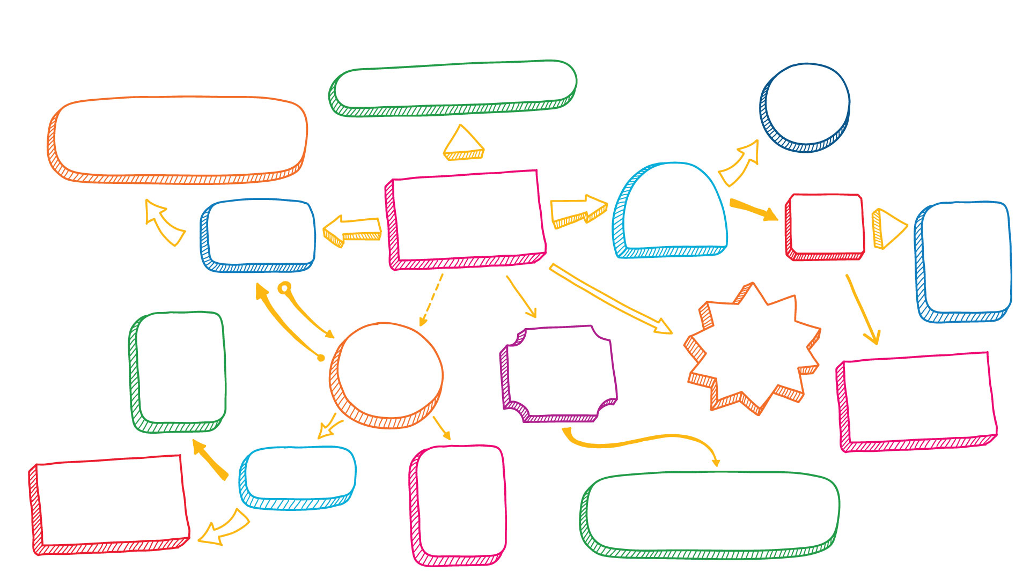
Activity 2
My Global Goal Getters magazine ideas
What format is my entry going to take?
What is my entry going to be about?
Slide 1 of 1 | Visual prompt
Notes:
Teacher notes: Activity 2/Slide 2 of 7 (Generating content: Pupil worksheet) (no animation)

Slide 9
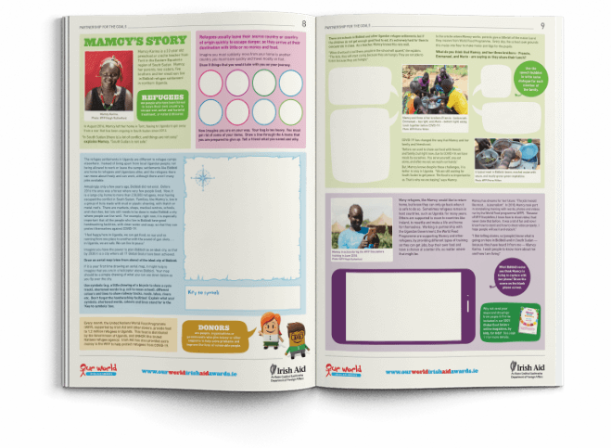
Activity 2
https://www.ourworldirishaidawards.ie/pupils-magazine/
Slide 3 of 7 | Generating ideas
Notes:
Teacher notes: Activity 2/Slide 3 of 7 (Generating ideas) (1 animation at * Click)
Explain that to get some more ideas about what topic their entries are going to be about and what format their content might take, they are going to take a few minutes to look at the Our World Irish Aid Awards pupil’s magazine. This magazine is produced every year for primary pupils to support learning about the Global Goals and the work of Irish Aid.
Access the Our World Irish Aid Awards pupil’s magazine here: https://www.ourworldirishaidawards.ie/pupils-magazine/
Prompt pupils to continue to populate their mind map as they browse the pupil’s magazine.
Explain that they can add shapes and connecting lines or arrows as needed.
Take a moment to remind pupils that the Global Goal Getters magazines are online magazines, meaning that are interactive and can include video or audio, so that the potential in terms of format is broad.

Slide 10
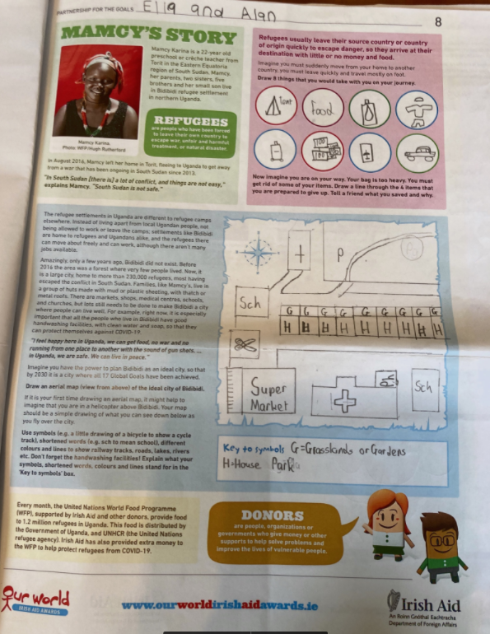
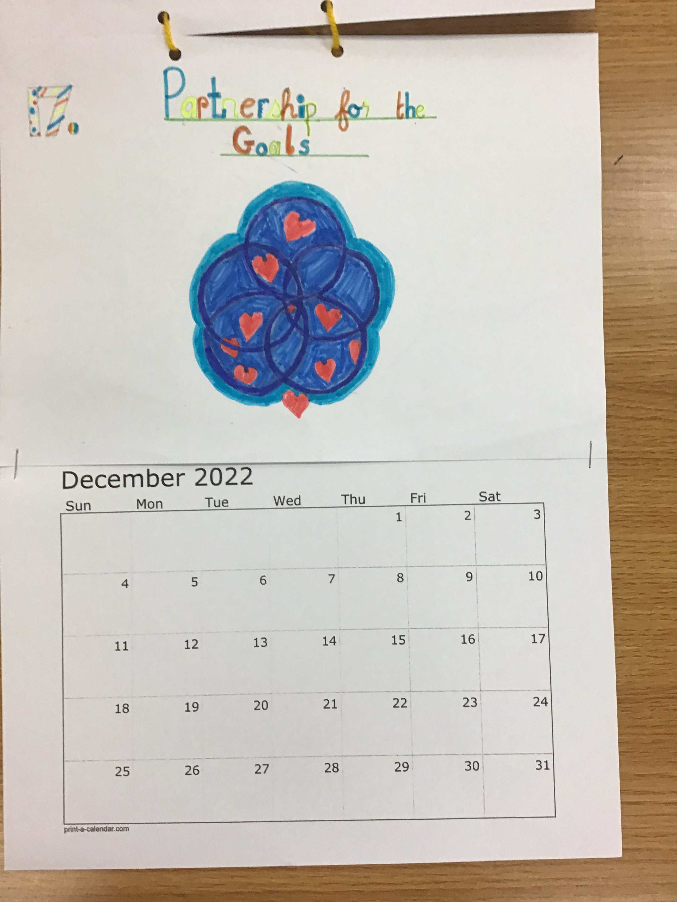
Activity 2
Global Goals Calendar
Entry from 3rd-4th class,
Ballyfeeney National School, Roscommon
Booklet showing pupil’s work in the OWIAA magazine.
Entry from two pupils in Lisdoonan National School, Monaghan
Slide 4 of 7 | Generating ideas
Notes:
Teacher notes: Activity 2/Slide 4 of 7 (Generating ideas) (no animation)
Explain that seeing examples of work submitted by primary pupils for the first issue of the Global Goal Getters online magazine might help the class decide what topic they what they are going to focus on and what format they are going to use.
Explain that the two examples on the slide are from two different schools. In the first example on the right, a 3rd-4th class in Roscommon created a calendar with a different Global Goal for each month. The second example is a page from a booklet that was submitted with examples of the different things that children did in pairs in response to the activities in the Our World Irish Aid Awards pupils magazine (available: https://www.ourworldirishaidawards.ie/pupils-magazine/) .

Slide 11
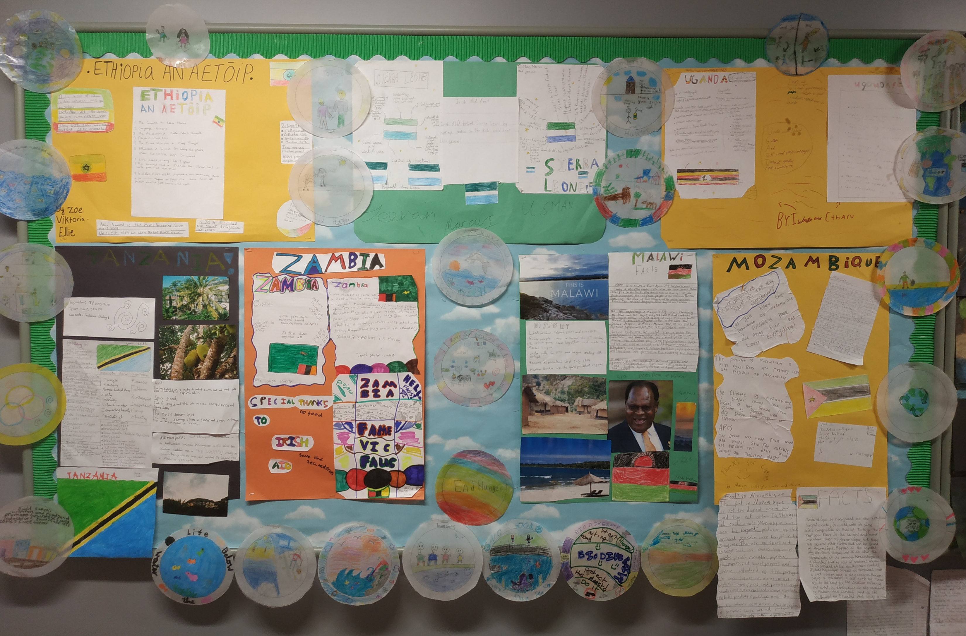
Activity 2
Teacher comment:
As part of our Geography Week, 4th Class have been looking at the work of the Irish Aid programme abroad in countries such as Sierra Leone, Vietnam, Ethiopia, Zambia, Mozambique, Uganda and Tanzania. Pupils learned about the 17 Global Goals for Sustainable Development that the United Nations have agreed to try and reach by 2030.
They've created stained-glass artworks of these goals to display outside their class for the rest of the school to see. All pupils are working together in groups to research and create information posters about the different countries that the Irish Aid programme is helping.
Display of Irish Aid focus country information and stained glass artworks on the theme of ‘Partnership for the Goals’
Entry from 4th class, Limerick School Project
Slide 5 of 7 | Generating ideas
Notes:
Teacher notes: Activity 2/Slide 5 of 7 (Generating ideas) (no animation)
Read the comment from the teacher who submitted this photograph of her pupils’ work, inspired by the Our World Irish Aid Awards pupils’ magazine (available: https://www.ourworldirishaidawards.ie/pupils-magazine/) and the stained-glass window activity in Lesson One (available: https://www.ourworldirishaidawards.ie/lesson-plans-2020-2021/).

Slide 12
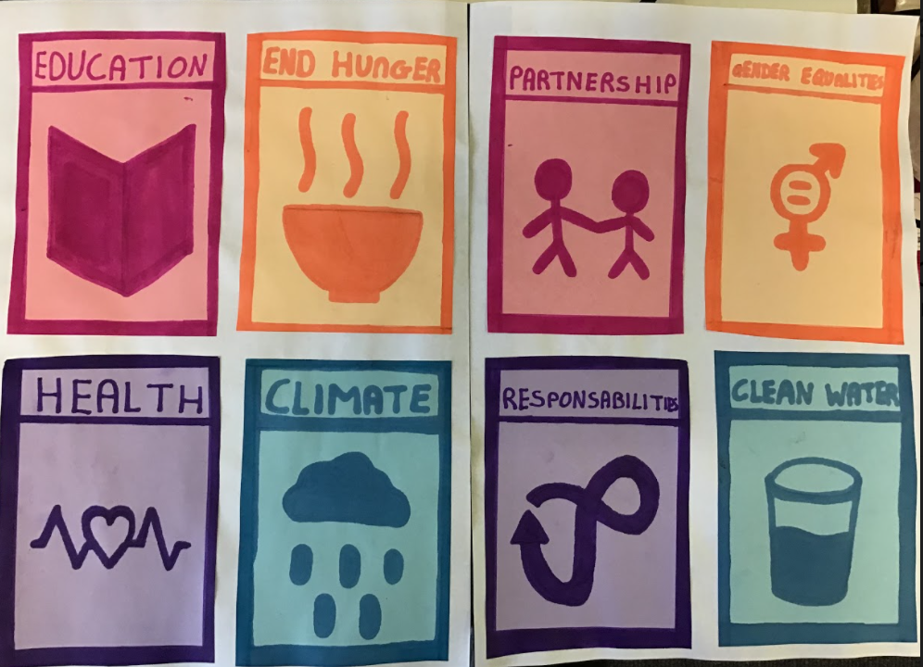
Activity 2
A million dreams
(The Greatest Showman)
lyrics focusing on the 2021 Award theme: Partnerships for the Goals
Entry from 3rd class, Ballina Primary School, Tipperary
Poster featuring drawings of 8 Global Goals
Entry from a pupil in Scoil Mhuire Moylagh, Co Meath
Slide 6 of 7 | Generating ideas
Notes:
Teacher notes: Activity 2/Slide 6 of 7 (Generating ideas) (no animation)
Explain that the example on the right comes from pupils who did drawings of the icons for 8 of the Global Goals.
In the second example, on the left, pupils were inspired by the 2021 Awards theme “Partnership for the Goals’, and rewrote the lyrics ‘A Million Dreams,’ from the movie, ‘The Greatest Showman’.
For more examples of Global Goal Getters online magazine entries from primary pupils see: https://www.ourworldirishaidawards.ie/global-goal-getters/

Slide 13
Activity 2
Topic? |  | Format?
One or more of the Global Goals for Sustainable Development
Partnership for the Goals (2021 Awards theme)
The work of Irish Aid in focus countries
Slide 7 of 7 | Generating ideas
Notes:
Teacher notes: Activity 2/Slide 7 of 7 (Generating ideas) (no animation)
Invite pupils to call out their ideas for what their entries might be about (topic focus), adding their responses underneath the 3 prompts in the table on the left.
[NB: to insert text into the table you must be in ‘normal’ rather than ‘presenter’ mode]
Invite pupils to call out their ideas for possible formats of their entries, recording their responses in the table on the right of the slide.
Depending on your class, you might find it useful to give some of these formats as prompts:
Crossword puzzles or word searches
Quiz
Photographs
Interviews
Paintings or drawings
Short stories
Play or other type of performance
Song or rap
Poem
Recipe
Infographics
Survey results
Posters
Advertisements
etc

Slide 14
Activity 3
Slide 1 of 2 | Global Goal Getters
Notes:
Teacher notes: Activity 3/Slide 2 of 2 (Global Goal Getters)
At this point, you should use the list of topics/formats on Slide 13 to decide whether you want to:
give individual pupils the freedom to choose the topic and format of their Global Goal Getters entry
organize a vote to decide on the preferred topics/formats and allocate preferred topics/formats to individuals or small groups
decide on one topic and format yourself and make a class submission
If you or your pupils wish to produce a magazine in small groups or as a class submission, we have a fun and interactive magazine template available, here: https://www.ourworldirishaidawards.ie/deadline-extension/
Remember: submissions for issue 3 of the Global Goal Getters magazines are ongoing from now through April – so you have plenty of time to start! Your class will be in with a chance to be featured in the online magazine, and may also be invited to the National Final in June, where they could win some cool prizes and awards.
Please complete an Entry Form (available for download from our website) and submit your work via email: ourworld@realnation.ie or by post to: Our World Irish Aid Awards
Real Nation
24 Arran Quay Dublin 7
D07 W620
Further information is available: www.ourworldirishaidaward.ie Please email or ring our project office if you have any queries about the Our World Irish Aid Awards or submission details E: ourworld@realnation.ie / P: 01 522 4834H
We would love to hear about how you are getting on with the curriculum materials and Award entries. You can share your Our World Irish Aid Awards 2021 journey with us @Irish_Aid / @ourworldawards on social media using the hashtag #ourworldawards

Slide 15
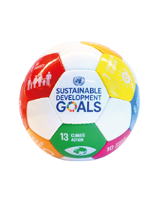
Activity 3
We have…
revised key content from Lessons 1-3
learned how we can enter our work to appear in Irish Aid’s Global Goal Getters online magazine, by kids, for kids
Well done class!
You’re all amazing Global Goal Getters!
Slide 2 of 2 | Global Goal Getters
Notes:
Teacher notes: Activity 3/Slide 2 of 2 (Global Goal Getters) (4 animations * Click – 3 come in one after another on the 2nd Click)
Explain to pupils that they are going to think about (reflect) on what they have learned in this lesson.
Invite pupils to imagine they are playing basketball. As each of the things they were learning in this lesson appear on the screen pupils should mime:
Shooting and scoring the winning basket in the match – if they are happy that they have learned what they were supposed to learn
* Click to animate the ball dropping into the net to demonstrate what you mean
Dribbling the ball – if they need some more support from a partner (pupils or teacher) to be able to say that they have learned what was intended
* Click to animate each of the 2 learning intentions for this lesson in separately, reading each aloud as they appear.
Observe pupils to see who might need some extra support.
Reassure the class that they have done an amazing job and that they are all fantastic Global Goal Getters.
Don’t forget to check out www.ourworldirishaidaward.ie for more information about how to get your pupils work published in our Global Goal Getters online magazines!

