Slide 1
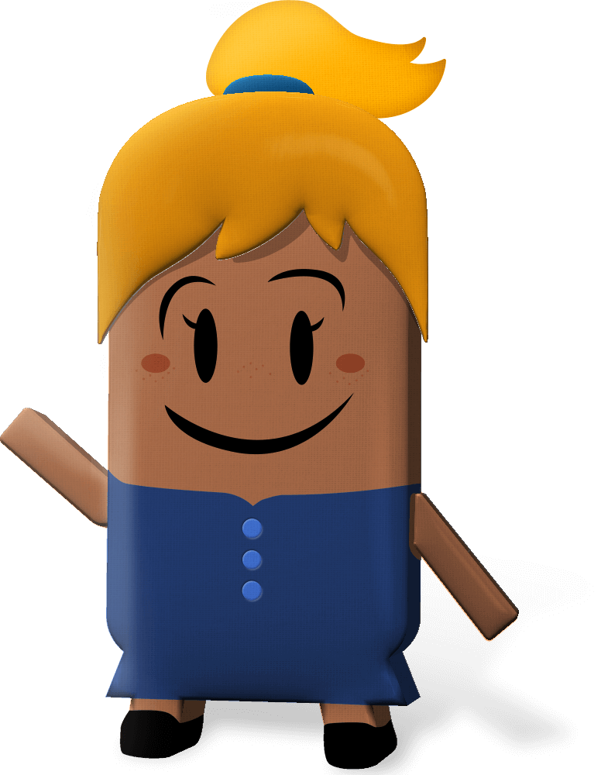
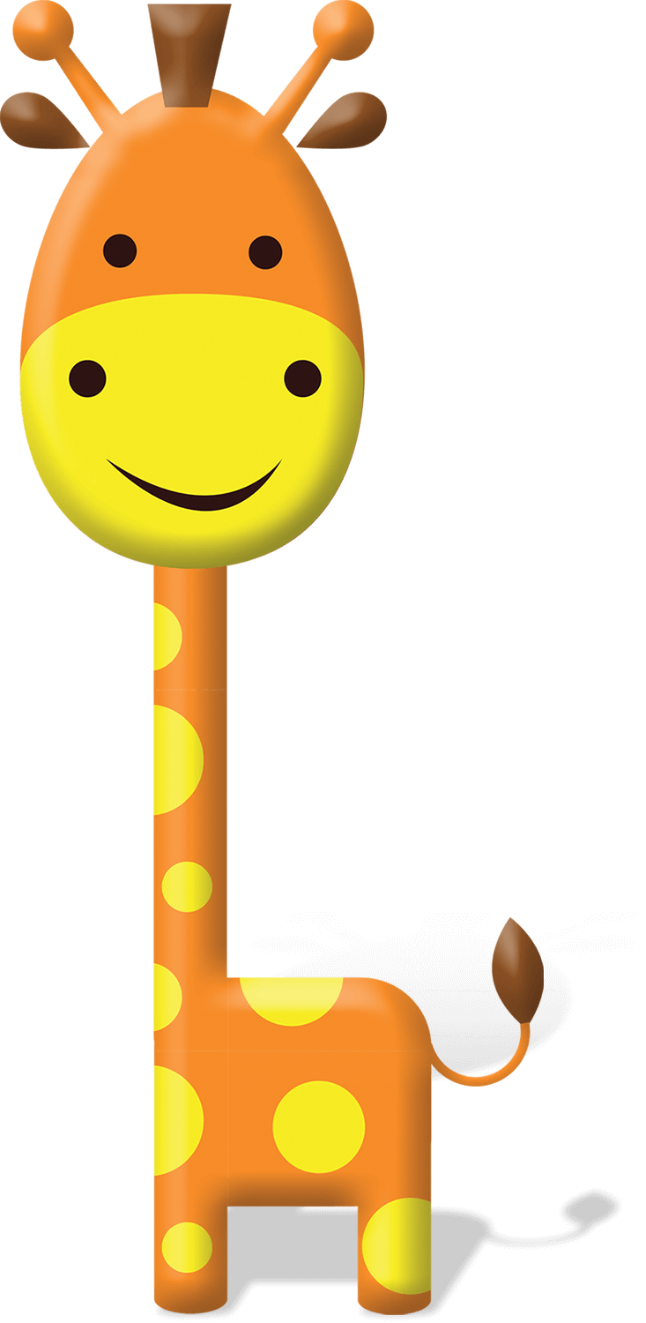
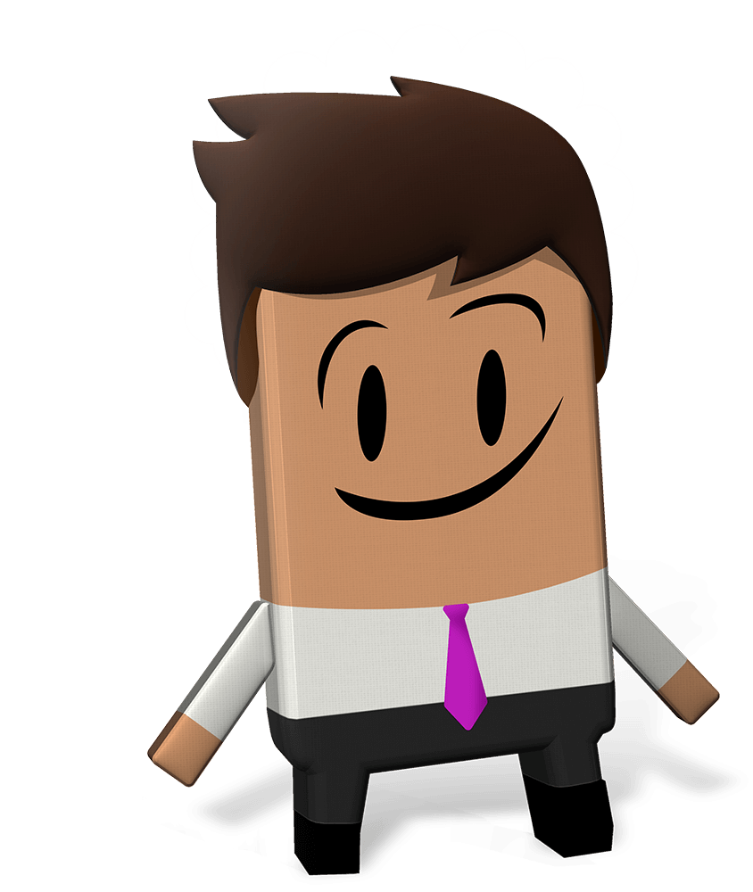
OUR WORLD IRISH AID AWARDS 2023
“EQUALITY FOR ALL”
LESSON ONE
(5th-6th class)
Notes:
Teacher notes: none

Slide 2
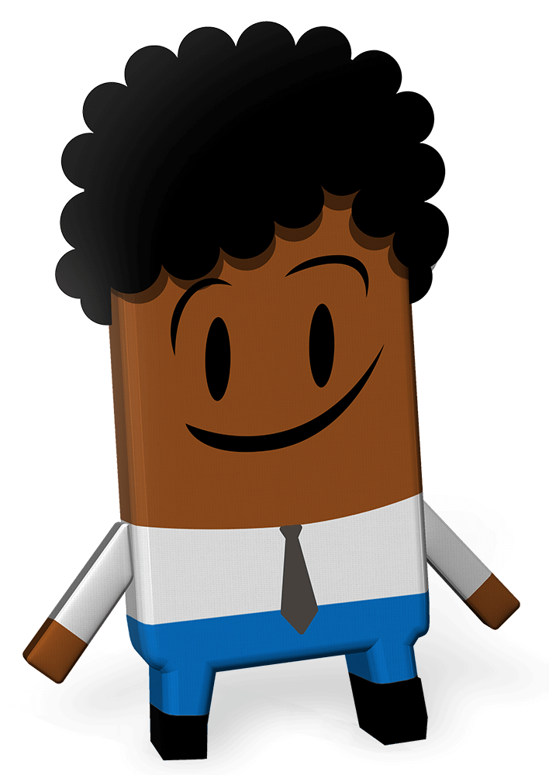
Curriculum Links
Curriculum area | Subject | Strand
SESE | Geography Science | Human environments Environmental awareness and care
SPHE |  | Myself and the wider world
Primary language | English Language 1 | Oral language Reading Writing
Arts Education | Visual Art | Drawing
Notes:
Teacher notes: none

Slide 3
Lesson Content
Activity No. | Activity name | Methodologies | Slide No.
Learning intentions |  | Sharing the learning intentions | 4
1 | Equality for All | Whole class discussion | pair work | 5-6
2 | Global Goals for Sustainable Development | Input | Short video with active listening questions | whole class discussion | 7-8
3 | Global Goal Getters | 2023 Our World Irish Aid Awards entry: input | 9
Reflection on learning |  | Checking in with the learning intentions | 10
Idea for an Awards entry |  | Postcard from our future selves | 11
Notes:
Teacher notes: none

Slide 4
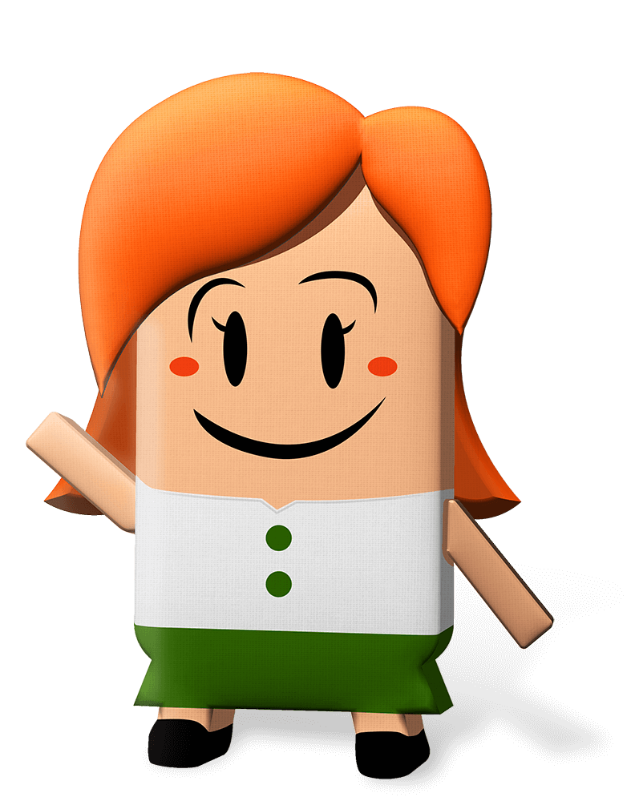
We are learning to…
consider the meaning of ‘Equality for All’
explore the Global Goals for Sustainable Development
come up with ideas for making the Global Goals happen
Notes:
Teacher notes: Learning intentions (3 consecutive animations at * Click)
Sensitivity note: As their teacher, you know your own pupils well. Please feel free to edit the lesson to best suit the needs in your class.
See also our Good Practice Guidelines for teaching about poverty and development in the Teacher’s section of www.ourworldirishaidawards.ie
* Click to animate in the learning intentions for this lesson, reading each aloud.
This is the first lesson for the 2023 Our World Irish Aid Awards. These Awards are a way for us to learn about what Irish Aid does, and to think about ways that we can help to make the Global Goals happen.
This lesson is all about the idea of ‘equality,’ and how we can work for equality by helping to make the Global Goals for Sustainable Development happen.
Don’t worry if you don’t know what equality means, or if you haven’t heard about the Global Goals before. This will all become clear.
Do you see the Irish Aid logo in the bottom right of the slide?
Irish Aid is part of the Irish Government. Irish Aid works for Equality for All by working with other governments, with different groups (international groups like the United Nations, non-governmental organisations or NGOs), and with communities in countries around our world. You will be learning more about the work of Irish Aid as we go through the lessons.

Slide 5
What does ‘Equality’ mean?
Activity 1
Universal Declaration of Human Rights
Article 1: All human beings are born free and equal. We are worth the same, and have the same rights. We are born with the ability to think and to know right from wrong, and should act toward others in a spirit of friendliness.
Article 2: Everyone is equal regardless of background, our gender, where we live, the languages we speak, what we look like, what we think or believe, how much money we have, our abilities.
Equality is more than just ‘treating everyone the same’.
Equality is about including everyone, treating all people fairly so that the outcome for each person can be the same. This can mean putting special supports in place for people who are somehow at a disadvantage.
Being treated equally and treating others equally is both a human right and a human responsibility.
Notes:
Teacher notes: Activity 1 (Equality for All) (3 animations at * Click)
What words/phrases come to mind when you see the word ‘Equality’? [Possible answers: equal, fairness, rights, opportunities]
Take feedback from a selection of pupils, recording their response on the board.
* Click to animate in a simplified articles 1 and 2 of the Universal Declaration of Human Rights (UDHR).
The UDHR was adopted in 1948 in response to World War II. It is made up of 30 articles. Read through the two articles on the slide. Do you want to add any words/phrases to what you have already come up with for the word ‘Equality’?
* Click to animate 3 consecutive points about ‘Equality’, reading each aloud.

Slide 6
Equality for All
Activity 1
Notes:
Teacher notes: Activity 1 (Equality for All) (2 animations at * Click)
In maths, we use the equals sign = to show that the value of what is on one side is the same as that on the other side of the equals sign. For example, 3 x 4 = 12 or 20 / 5 = 4.
In pairs, do a quick drawing that includes the equals sign and shows the idea of Equality for All.
Take feedback from a selection of pairs.
There are several ways of thinking about the phrase ‘Equality for All’:
All people, no matter where they live, who they are or what they own, have the right to be included, treated fairly and equally.
* Click to animate in an image representing the point above.
If everyone is treated equally then we all benefit. For example, if all children have the same chance to go to school and get a good quality education then they are better able to get decent work and care for their families.
* Click to animate in the UN logo.
Does anyone recognise the blue globe on the slide? This is the logo of the United Nations. Can anyone tell me what the United Nations is? It is an international organisation, like a big club, made up of 193 countries, including Ireland. Together these 193 countries make decisions about our world, and how we can all live together sustainably, in equality and peace.

Slide 7
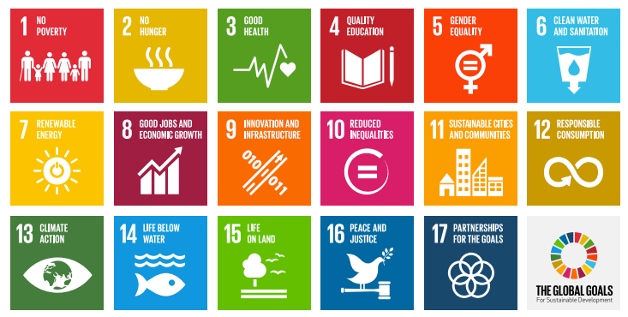
Activity 2
All countries in the United Nations agreed to achieve 17 Global Goals by the year 2030
The Global Goals are designed to help make sure that all people are included and treated fairly and equally and that we all take care of our planet
Everyone needs to work together to make sure that the Global Goals happen
Notes:
Teacher notes: Activity 2 (The Global Goals for Sustainable Development) (3 animations at * Click)
Have you ever seen this image before? These are the United Nations Sustainable Development Goals, or the Global Goals.
* Click to animate in the first bullet point
The 17 Global Goals are a plan that was designed by the United Nations.
* Click to animate in the second bullet point
The Global Goals are about working together for Equality for All. They talk about things like being able to go to school to learn and go to a doctor when you are sick, about having enough good food to eat, about being treated fairly, and being paid fairly for the work that you do. The Goals are also about taking care of our planet, which we depend upon for our survival.
* Click to animate in the third bullet point
The Global Goals are universal. This means that they are for everyone and especially the people in our world who are treated unfairly or disadvantaged – people who do not have enough good food or clean water to live well or cannot afford to send their children to school or get medical help when they need it. The fact that the Goals are universal also means that we all have a part to play in making them happen.
Depending on how familiar your class are with the Global Goals, you could display the child-friendly version of the 17 Global Goals in the Our World Irish Aid Awards pupils’ magazine, page 4 (available: https://www.ourworldirishaidawards.ie/pupils-magazine/)

Slide 8
Activity 2
Pick one of the following questions.
Listen out for the answers in the video.
How many times is the word inequality mentioned?
What examples of inequality are given?
What practical suggestions are given to deal with inequality.
Notes:
Teacher notes: Activity 2 (The Global Goals for Sustainable Development) (no animations)
Has anyone ever heard of Malala Yousafzai? What do you know about Malala?
Malala is an activist, someone who takes action to bring about positive change in our world. Malala supports gender equality in our world by supporting girls to go to and stay in school.
We are going to watch a video about the Global Goals which is introduced by Malala. As you watch, you need to find the answer to one of the questions on the slide.
Click on the image on the slide to play the video (6.19mins) (also available: https://www.youtube.com/watch?v=p2hyORs83EE (English language version) or https://youtu.be/fpjIu2446PY (Leagan Gaeilge).
For each of the 3 questions, take feedback from a selection of pupils.
Answers:
Two.
Poverty, healthcare, education and gender.
Stick up for people who aren’t being treated fairly; respect the human rights of others; take care of each other; share what we produce fairly and sustainably.
What did you learn from this video about the relationship between Equality for All and the Global Goals? Do you agree with the following: Equality for All = Global Goals?

Slide 9
Activity 3
Notes:
Teacher notes: Activity 3 (Global Goal Getters)
We are going to take part in the Our World Irish Aid Awards.
Entries must be about the 2023 Awards theme of ‘Equality for All’, the Global Goals generally and/or the work of Irish Aid in different countries.
Our entry can be in any format. This means we can enter short stories, poems, surveys, video of a performance, posters or something else. So, get your thinking caps on!
We can take as much or as little time as we like to create our entry and we can enter more than once.
For entering we will get a certificate of participation. Our entry might be published in one of the online Global Goal Getters magazines, by kids, for kids. In June 2023, the teachers/pupils with the best entries will be invited to a National Awards final and their work will appear in the Global Goal Getters Annual, online and as an insert in a national newspaper. Each winner will receive copies of the Global Goal Getters Annual and a plaque or trophy for their school.
For more information and entry details for the Our World Irish Aid Awards see: www.ourworldirishaidawards.ie

Slide 10
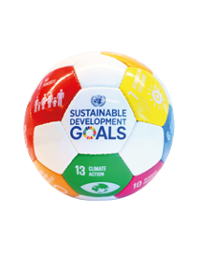
We have learned to…
consider the meaning of ‘Equality for All’
explore the Global Goals for Sustainable Development
come up with ideas for making the Global Goals happen
WELL DONE CLASS!
You’re all amazing
Global Goal Getters!
Notes:
Teacher notes: Reflection on learning (4 animations at * Click – 3 come in one after another on the 2nd Click)
Let’s take a few minutes to think about what we have learned in this lesson.
Imagine you are playing basketball.
As each of the learning intentions for this lesson appear on the board, you should mime:
Shooting and scoring the winning basket in the match – if you are happy with your learning
* Click to animate the ball dropping into the net to demonstrate what you mean
Dribbling the ball – if you still need a little support with this
* Click to animate each of the learning intentions for this lesson, reading each aloud as they appear.
Observe pupils to see who might need some extra support.
You have all done an amazing job and are all fantastic Global Goal Getters.

Slide 11
Idea for an Awards entry…
Tuesday, 31st December 2030
2030
2023
Notes:
Teacher notes: Idea for an Awards entry (1 animation at * Click)
2030 is the year that the United Nations aims for the Global Goals to be achieved. Let’s write a postcard from 2030 to someone living in 2023.
* Click to animate the clock going from 2030 to 2023.
Your postcard can be addressed to your younger self, another person, a non-governmental organisation, government (or a section of the government, like Irish Aid), or international organisation (like the United Nations).
You should say what it is like to live in 2030 with all the Global Goals achieved and share your ideas for what people in 2023 can do to get to this point. You can design your 2030 stamp and draw the Global Goal(s) most relevant to your text on the front of your postcard.
Ask your teacher to send us your postcard (entry details on www.ourworldirishaidawards.ie). You never know, your work might be published in one of the 2023 online Global Goal Getters magazines, by kids for kids.

