Slide 1
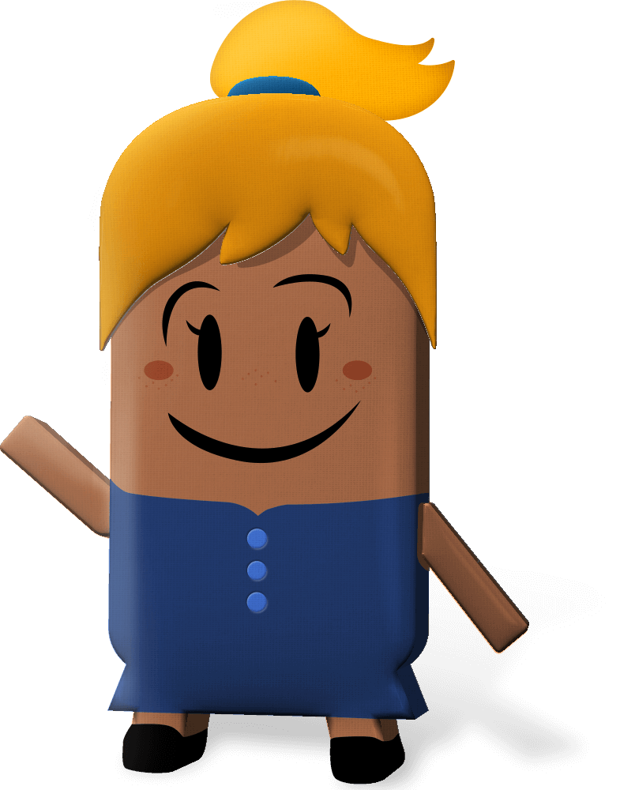
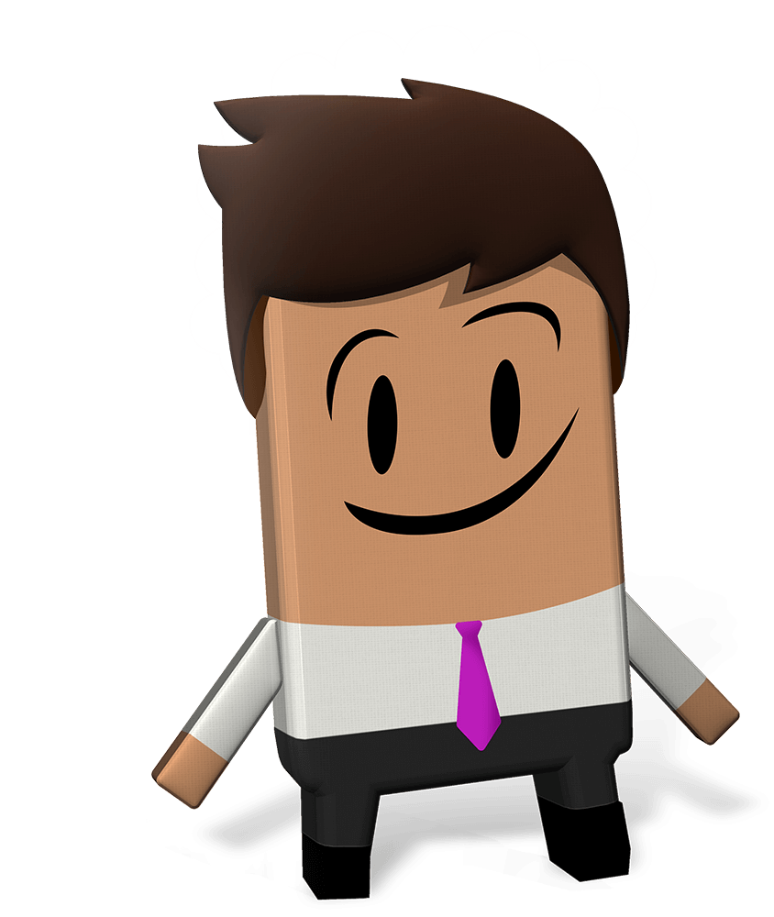
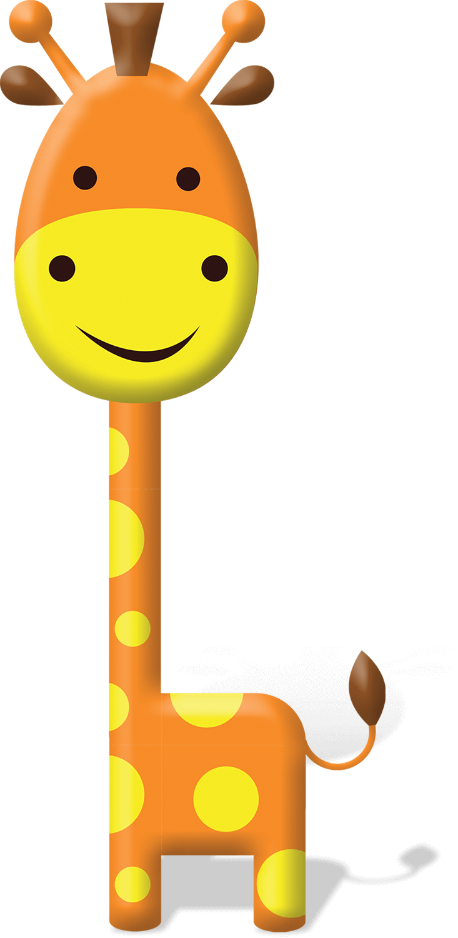
OUR WORLD IRISH AID AWARDS 2023
“Equality for All”
LESSON TWO
(5th-6th class)
Notes:
Teacher notes: none

Slide 2
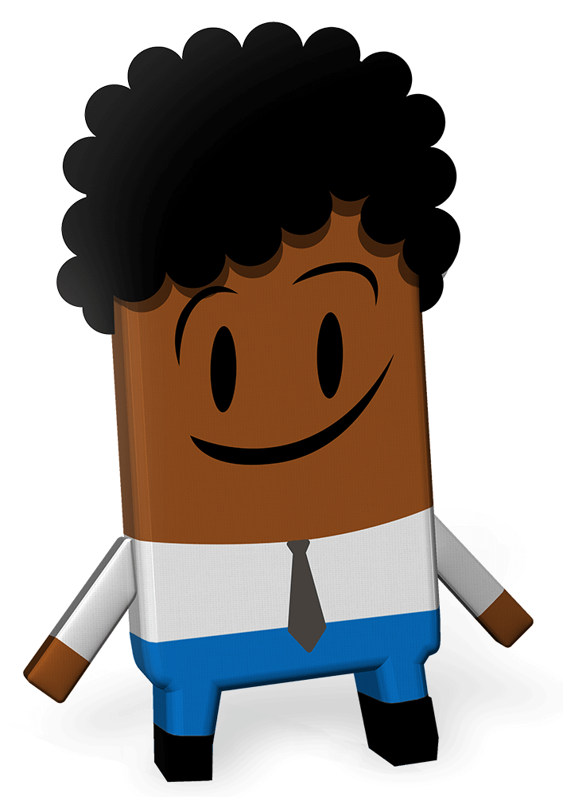
Curriculum Links
Curriculum area | Subject | Strand
SESE | Geography | Human environments
 | History | Politics, conflict and society
SPHE |  | Myself and others Myself and the wider world
Primary language | English Language 1 | Oral language Reading Writing
Notes:
Teacher notes: none

Slide 3
Lesson Content
Activity No. | Activity name | Methodologies | Slide No.
Learning Intentions |  | Sharing the learning intentions | 4
1 | Irish Aid | Input | 5
2 | Stories of progress | Q&A with the focus country information | 6-9
3 | Global Goal Getters | 2023 Our World Irish Aid Awards entry: input | 10
Reflection on learning |  | Checking in with the learning intentions | 11
Idea for an Awards entry | In your own time… | Irish Aid wordsearch | 12
Notes:
Teacher notes: none

Slide 4
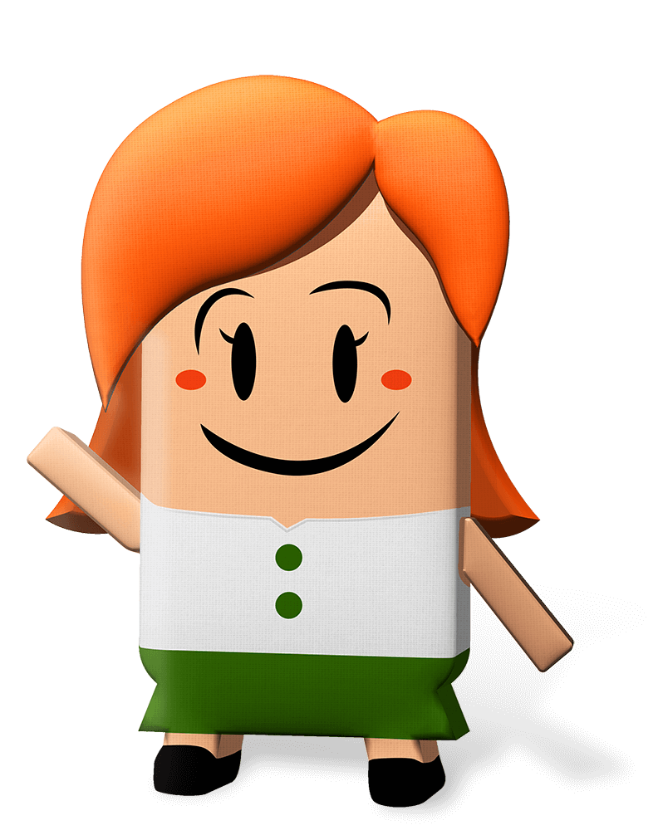
We are learning to…
identify what Irish Aid is and does
discuss the links between Irish Aid work around our world and the Global Goals
Notes:
Teacher notes: Learning intentions (2 consecutive animations at * Click)
Sensitivity note: As their teacher, you know your own pupils well. Please feel free to edit the lesson to best suit the needs in your class.
See also our Good Practice Guidelines for teaching about poverty and development in the Teacher’s section of www.ourworldirishaidawards.ie
Ask for volunteers to read the two learning intentions for Lesson Two.
* Click to animate in the learning intentions, one after another.
Check for comprehension of tricky words, explaining as necessary.
This is the second lesson for the 2023 Our World Irish Aid Awards. It is all about what Irish Aid is and does in different countries to make sure that all people are included, treated fairly and equally.

Slide 5
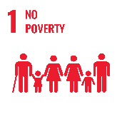
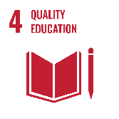
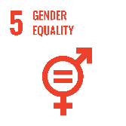
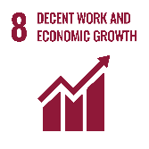
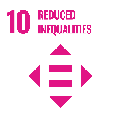
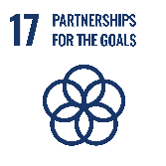
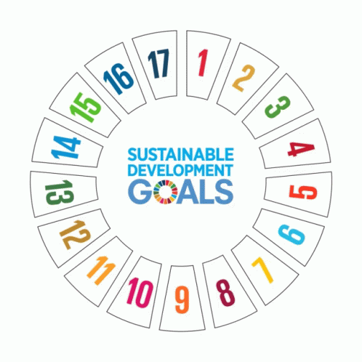
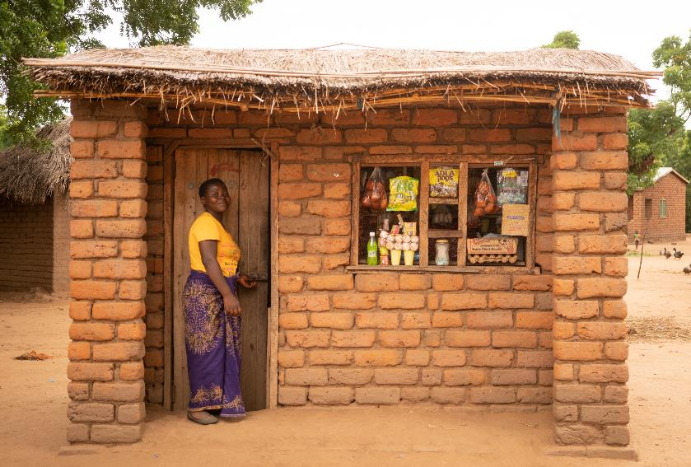
Activity 1
Tiwoloke
Chichewa
Notes:
Teacher notes: Activity 1 (Irish Aid) (3 animations at * Click)
The Government of Ireland has a programme for overseas development cooperation called Irish Aid. Overseas development cooperation is a tricky term. It means working to end hunger and poverty and tackle climate change. Irish Aid does this on behalf of the people of Ireland. For this reason, it is important that we learn about Irish Aid.
Irish Aid works with international organisations like the United Nations, other governments, with non-governmental organisations (or NGOs, like Concern Worldwide), and with communities, in countries all over our world, to try to make the Global Goals happen, so that everyone is included, treated fairly or equally so that we can all build a better world for our families.
* Click to animate in the 17 Global Goals gif
The 17 Global Goals are universal. This means that they are for everyone, especially the people who are most at risk – those who do not have enough good food or clean water or people who cannot afford to send their children to school or get medical help when they need it.
The fact that the Goals are universal means that people, like you and me, all have a responsibility to do something about the Global Goals. Countries that have more money, like Ireland, should support countries with less, for example, Malawi, so that the Global Goals are progressed. This is what Irish Aid is trying to do.
* Click to animate in the photograph Mary Joseph
This is Mary Joseph. She lives with her husband and two sons in a village in Malawi. In 2018, Mary Joseph joined an Irish Aid funded programme that is run by Concern Worldwide called Tiwoloke (which means ‘Let’s cross’ in Chichewa, a local language in Malawi).** Before taking part, Mary Joseph’s family were struggling with poverty and inequality. Because of her own hard work, the business training and support from the Tiwoloke programme Mary Joseph built a successful shop. She was able to save to build a new home and buy a bicycle. This is an example of the support that Irish Aid provides in different countries around our world.
** To hear the correct pronunciation of the words ‘Tiwoloke’ and ‘Chichewa’ click on the sound recordings underneath the photograph of Mary Joseph.
* Click to animate in the Goals relevant to this story of progress in Malawi
The Global Goals that are linked to this story of progress are Goal 1: No poverty, Goal 4: Quality Education; Goal 5: Gender equality, Goal 8: Decent work, Goal 10: Reduced inequalities, Goal 17: Partnership for the Goals.
Find out more about Irish Aid supported work in Malawi on pages 5-6 of the 2023 pupil’s magazine and in Lesson 3 (Teacher’s section: www.ourworldirishaidawards.ie)

Slide 6
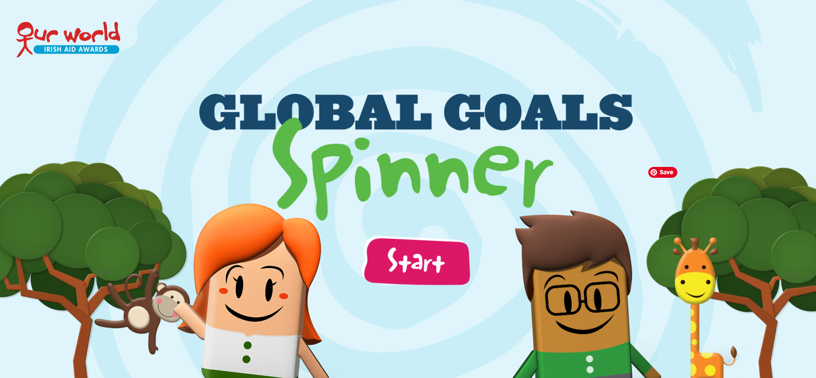
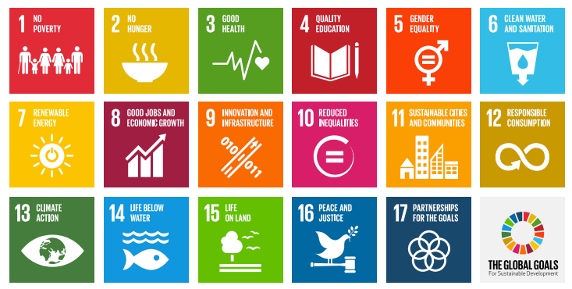
Activity 2
STORIES OF PROGRESS
Notes:
Teacher notes: Activity 2 (Stories of progress) (no animation)
Sensitivity note: If you have pupils have connections with one of the countries in Activity 2, check whether they would like to contribute as you run through Slides 7–9. See our Good Practice Guidelines for Teaching about Development in the Teacher’s section of www.ourworldirishaidawards.ie
Let’s find out more about Irish Aid work to make the Global Goals a reality in countries all over our world.
NB: Slides 7-9, together with page 5 of the 2023 Our World Irish Aid Awards pupils magazine, includes all the information your pupils need to compete against the clock in our updated online Global Goal Spinner game, available: https://globalspinner.ourworldirishaidawards.ie/#/game/title

Slide 7
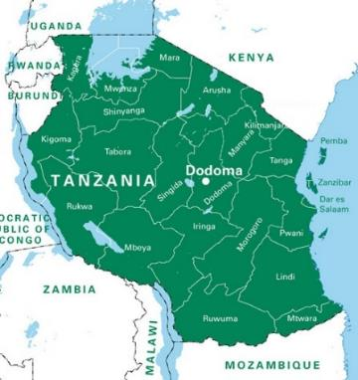
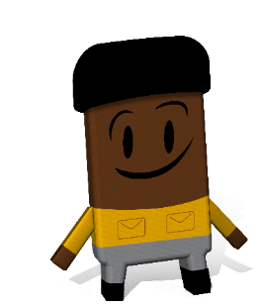
Activity 2
Ethiopia
Population: 120.8 million
Story of progress: Working with the Ministry of Health in Ethiopia, Irish Aid gave money for the vaccination of 15 million children against measles.
Tanzania
Population: 63.3 million
Story of progress: Irish Aid gave money for a climate smart agriculture project in the Dodoma region in Tanzania. This project set up a market for farmers so that they could sell their sorghum (millet) crop.
Uganda
Population: 48.4 million
Story of progress: Rinyamoe Ignatius Loyla is a retired Ugandan government worker. With funding from Irish Aid, Rinyamoe worked with UNICEF (a United Nations agency) and Voluntary Service Overseas (a non-governmental organisation) to turn his garden into an outdoor classroom for local children during COVID-19 school closures.
“My love for education inspired me” – Rinyamoe Ignatius Loyla
Ethiopia, Tanzania and Uganda are all in East Africa. Can you find these 3 countries on a map of our world?
Malala Yousafzai
Notes:
Teacher notes: Activity 2 (Stories of progress) (3 consecutive animations at * Click)
Invite 3 pupils to read the information on the slide about Ethiopia, Tanzania and Uganda. Explain any tricky words/phrases. For example, sorghum (Tanzania), or millet, is a crop that is used as an alternative to rice or turned into flour for baking etc.
Divide the class into pairs/small groups.
I am going to ask you three questions, one about each country on the slide. You and your partner/group should discuss the question and record your answers. Then, I’ll tell you what the answers are.
If your class likes competition, you could do this in a quiz format. There are 8 questions on slides 7-9, so plenty of opportunity for winners. Pairs/groups can pick their group name and you could have a leader board or keep a tally that changes after each slide.
1. List the Global Goals linked to Irish Aid’s work in Ethiopia. For reference, Slide 6 includes a visual of the 17 Global Goals.
2. Can you name a country that borders Tanzania? If you have a map of our world on the wall, you might want to point to this.
3. Rinyamoe Ignatius Loyla’s passion for education inspired him to donate his garden as an outdoor classroom. In lesson 1 / page 3 of the pupil’s magazine, we met another (famous) person who shares Mr Loyla’s passion. Who is this person?
After you share each of the three answers (below) * click x 3 for supporting visuals to appear on the slide. Ask for a show of hands for correct answers.
1. The Global Goals that can be linked to Irish Aid’s work in Ethiopia are Goal 4: Quality education; Goal 10: Reduced inequalities; and Goal 17: Partnership for the Goals.
2. Tanzania is bordered by Kenya, Mozambique, Zambia, Democratic Republic of Congo, Burundi, Rwanda and Uganda.
3. Malala Yousafzai, like Mr Loyla, is passionate about the value of education and she works hard to make sure that girls go to and stay in school.

Slide 8
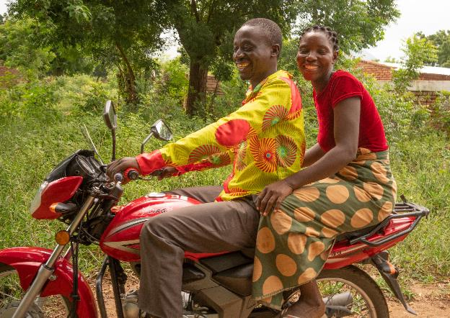
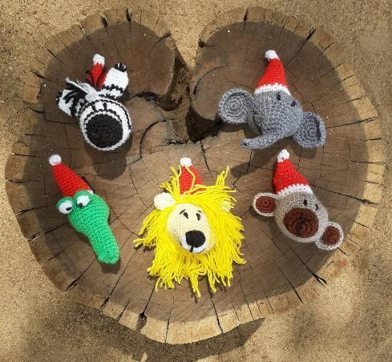
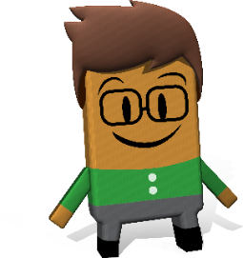
Activity 2
Malawi
Population: 20.2 million
Story of progress: Landen and Eliza Manjolo took part in Concern Worldwide’s Tiwoloke programme. The support they received meant that they were able to start a motorcycle taxi business. The money they earned from this business meant they could build a new kitchen.
Malawi and Mozambique are neighbouring countries in Southeast Asia. Can you find these 2 countries on a map of our world?
Mozambique
Population: 33.1 million
Story of progress: Irish Aid provided funding to a crochet group in Manhure Village in the Niassa reserve (park) to teach 18 women and 2 men how to make toys of local wildlife. They use the money from selling these toys to buy food for their families.
Notes:
Teacher notes: Activity 2 (Stories of progress) (2 animations at * Click)
Invite 2 pupils to read about Malawi and Mozambique. Explain any tricky words/phrases. For example, a reserve (Mozambique), or nature/wildlife park, is a protected area.
Let’s see how you do on this slide. I’m going to ask two questions, one for each country on the slide. With your partner/group, you need to discuss these questions and record your answers.
1. Irish Aid gave money to Concern Worldwide (a non-governmental organisation) to support families, like the Manjolo family in Malawi (point to the photo on the slide) to move out of poverty. Name the Global Goals linked to Irish Aid’s work with Concern Worldwide in Malawi? For reference, Slide 6 includes a visual of the 17 Global Goals.
2. Name at least three animals that can be found in Mozambique.
As you share each of the two answers (below), * click for supporting visuals to appear on the slide. Ask for a show of hands for correct answers.
1. The Global Goals that can be linked to Irish Aid supported work in Malawi are Goal 8: Decent work and economic growth; Goal 10: Reduced inequalities; and Goal 17: Partnership for the Goals
2. (Top row, r-l) zebras, elephants; (bottom row, r-l) crocodiles, lions, monkeys are all animals that can be found in Mozambique.
Special recognition for anyone who noticed that the crochet animals are wearing Santa hats!

Slide 9
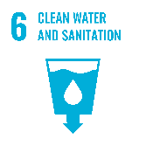
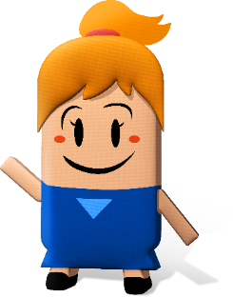
Activity 2
Sierra Leone
Location: West Africa
Population: 8.3 million
Story of progress: Ireland worked with the Ministry of Education in Sierra Leone to make sure that schools have clean water and working toilets.
Vietnam
Location: Southeast Asia
Population: 99 million
Story of progress: Irish Aid gave money to the Helen Keller International (a non-governmental organisation) to run agricultural training for people without paid jobs. Bui Thi Tiep, a mother of two, took part in this course and now has an impressive home garden, and trains other farmers in her community.
Zambia
Location: Southern Africa
Population: 19.5 million
Story of progress: Maria Mutambo from Zambia is one of 10 children. After secondary school, her family couldn’t afford for her to continue her education. But, Maria was able to take part in Irish Aid funded construction training and now works as a bricklayer.
Can you find these 3 countries on a map of our world?
Notes:
Teacher notes: Activity 2 (Stories of progress) (2 animations at * Click)
Invite 3 pupils to read about Sierra Leone, Zambia and Vietnam. Explain any tricky words/phrases.
This is the final set of questions. Let’s see how you do. I’m going to ask two questions, one about Sierra Leone and the other about Zambia and Vietnam together. As before, you discuss these questions with your partner/group and take note of your answers.
1. Name the Global Goals linked to Irish Aid’s work with the Ministry of Education in Sierra Leone? For reference, Slide 6 includes a visual of the 17 Global Goals.
2. Identify at least two Global Goals that can be linked to Irish Aid supported work in both Zambia and Vietnam.
After you share each of the two answers (below) * click for supporting visuals to appear on the slide. Ask for a show of hands for correct answers.
1. The Global Goals that can be linked to Irish Aid work with the Ministry of Education is Sierra Leone are Goal 4: Quality Education; Goal 6: Clean water and sanitation; Goal 10: Reduced inequalities; and Goal 17: Partnership for the Goals.
2. The Global Goals that can be linked to Irish Aid supported work in both Zambia and Vietnam are Goal 1: No Poverty; Goal 4: Quality Education; Goal 5: Gender Equality; Goal 10: Reduced Inequality.
NB: Slides 7-9, together with page 5 of the 2023 Our World Irish Aid Awards pupils magazine, includes all the information your pupils need to compete against the clock in our updated online Global Goal Spinner game, available: https://globalspinner.ourworldirishaidawards.ie/#/game/title

Slide 10
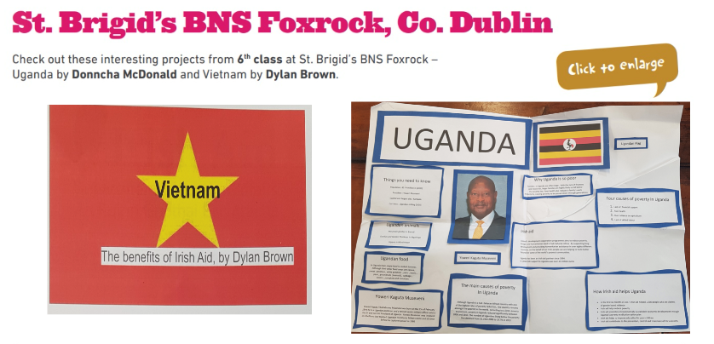
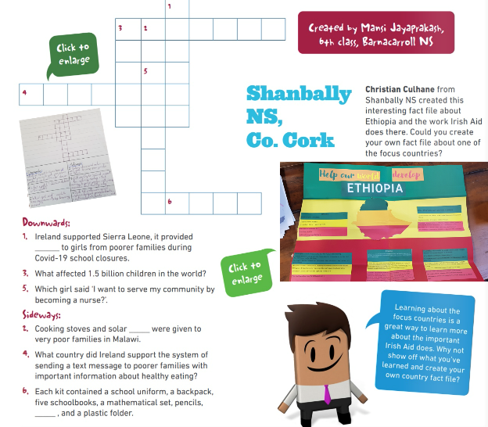
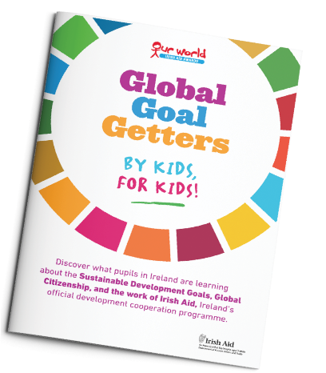
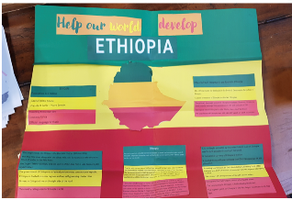
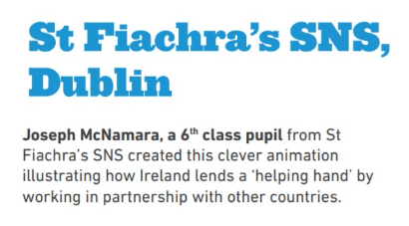
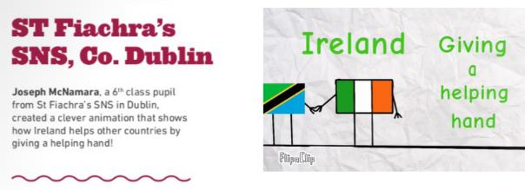
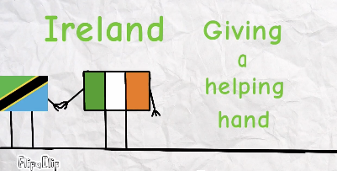
Activity 3
Here are some of the fantastic examples of children’s work published in Global Goal Getters online magazines in the past. See https://www.ourworldirishaidawards.ie/global-goal-getters/ for more great examples.
Notes:
Teacher notes: Activity 3 (Global Goal Getters) (3 consecutive animations at * Click)
We are going to take part in the Our World Irish Aid Awards.
Entries must be about the 2023 Awards theme of ‘Equality for All’, the Global Goals generally and/or the work of Irish Aid in different countries.
* Click to animate in the examples of Award entries
Read the narrative provided for each entry and comment on content focus (Irish Aid’s work to progress the Global Goals in different countries around our world) and the format of the entries (St Brigid’s BNS = PowerPoint and poster; St Fiachra’s SNS = animation; Barnacarroll NS = crossword puzzle).
Our entry can be in any format. This means we can enter short stories, poems, surveys, video of a performance, posters or something else. So, get your thinking caps on!
We can take as much or as little time as we like to create our entry and we can enter more than once.
For entering we will get a certificate of participation. Our entry might be published in one of the online Global Goal Getters magazines, by kids, for kids. In June 2023, the teachers/pupils with the best entries will be invited to a National Awards final and their work will appear in the Global Goal Getters Annual, online and as an insert in a national newspaper. Each winner will receive copies of the Global Goal Getters Annual and a plaque or trophy for their school.
For more information and entry details for the Our World Irish Aid Awards see: www.ourworldirishaidawards.ie

Slide 11
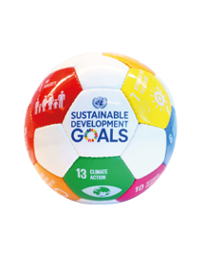
We have learned to…
identify what Irish Aid is and does
discuss the links between Irish Aid work around our world and the Global Goals
WELL DONE CLASS!
You’re all amazing
Global Goal Getters!
Notes:
Teacher notes: Reflection on learning (3 animations at * Click – 2 come in one after another on the 2nd Click)
Let’s take a few minutes to think about what we have learned in this lesson.
Imagine you are playing basketball.
As each of the learning intentions for this lesson appear on the board, you should mime:
Shooting and scoring the winning basket in the match – if you are happy that you have learned
* Click to animate the ball dropping into the net to demonstrate what you mean
Dribbling the ball – if you still need a little support from either myself or your classmates to be able to say that you have learned
* Click to animate each of the learning intentions for this lesson, reading each aloud as they appear.
Observe pupils to see who might need some extra support.
You have all done an amazing job and are all fantastic Global Goal Getters.

Slide 12
Idea for an Awards entry…
Notes:
Teacher notes: Idea for an Awards entry (no animations)
Create a wordsearch (10 rows and 10 columns) based on what you have learned about the work of Irish Aid to progress the Global Goals in different countries around our world.
Here’s some questions to help you remember everything you have learned so far.
What exactly is Irish Aid?
What other groups or organisations does Irish Aid work with?
Can you name any of the countries where Irish Aid works?
What kind of work does Irish Aid support?
What Global Goals can you link to the work that Irish Aid supports?
Why not get a friend or family member to give your wordsearch a go?
Ask your teacher to send us your wordsearch (entry details on www.ourworldirishaidawards.ie). You never know, your work might be published in one of the 2023 online Global Goal Getters magazines, by kids for kids.

